Slide 1
Redis
Nada mostafa

Slide 2
Redis (in-memory data store)
Is essentially a type of database and more specifically it is a nosql database
But it is not very similar to any other nosql dbs it is definitely not similar to mongodb & it’s obviously very different than sql db.
Why?
Because redis doesn’t really have any idea of tables or documents

Slide 3
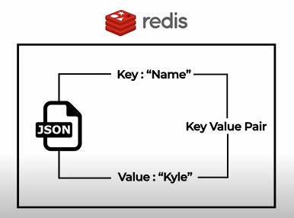
all the data in redis is stored inside of key value pairs so think about a json obj .
Redis is just like one giant json obj.

Slide 4
Info about redis
It’s not very good at storing a bunch of structured data like you have in sql
It’s really good for storing individual key value pairs that you need to access or get data from
another important thing to note about redis is that unlike a normal database that runs on your disk and stores all info in disk
Redis run inside your working memory (Ram)
This means that redis is fast because it runs in ram but it’s more volatile (unless you are backing it up)

Slide 5
Why redis is not used as persistent db like mongodb?
It’s used caching where you access a lot of data that take along time to compute and you store those values inside of redis that way when you need to access them in the future it’s incredibly quick since redis in the memory already loaded it’s milliseconds to get data

Slide 6
When we need redis
any time that you have a really long or slow query or you have a data you access all the time but doesn’t change that much you are going to do is you are going to store that data inside of redis
If we are going to speed this app up by about 10 to 50 times just by implementing redis

Slide 7
How we can install redis
Is really simple with mac or linux
If you are on mac just use homebrew to do the install
If you are on linux just use your package manager of choice to install it
It’s a bit more complex with windows
You need to do through the widows subsystem for linux
https://learn.microsoft.com/en-us/windows/wsl/install

Slide 8
Basic redis commands
SET name kyle //set value
GET name //get value “kyle”
Every thing you store inside of redis is string by default
SET age 26
GET age //”26”
Redis is smart enough to know this is an integer but it dosen’t matter because when you are accessing and dealing with these data . It is always going to come back to you as strings

Slide 9
Cont.
DEL age
GET age //null
EXISTS name // 1 1➔ true 0➔false
KEYS * //”name” find all keys
Flushall //delete every thing in database
KEYS * //(empty list or set)

Slide 10
